Slide 1

Cell-ebrating Efficiency: Optimization Algorithms Meet Biological Systems
Malachy McEvoy
Supervision by Dr. Andrea Weisse

Slide 2
The pursuit of cell-free protein synthesis (CFPS)

Slide 3
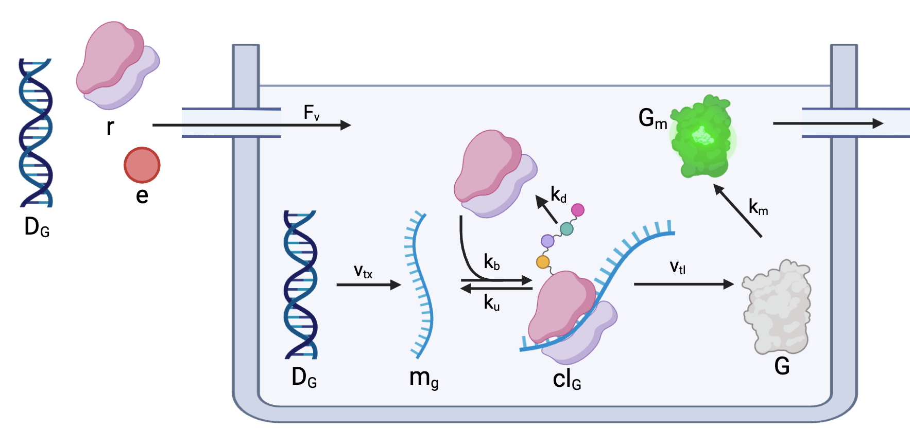
The pursuit of cell-free protein synthesis (CFPS)

Slide 4

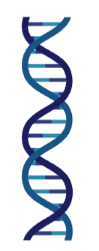

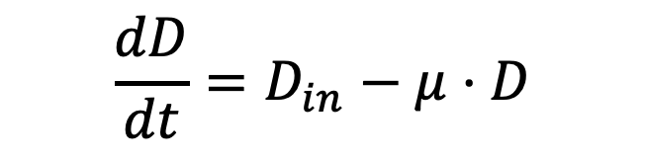
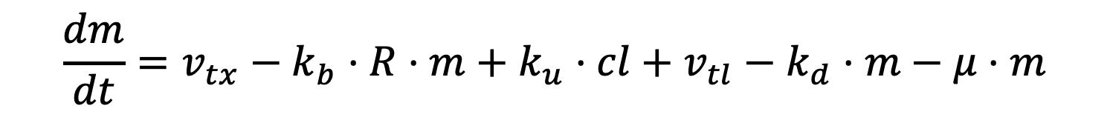
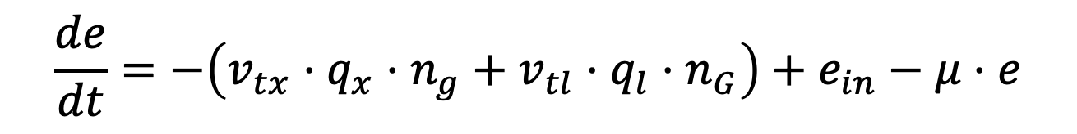
Modelling biological systems with ODEs
$$\frac{de}{dt}=−\left(v_{tx}⋅q_{x}⋅n_{g}+v_{tl}⋅q_{l}⋅n_{G}\right)+e_{in}−μ⋅e$$
$$\frac{dD}{dt}=D_{in}−μ⋅D$$
$$\frac{dm}{dt}=v_{tx}−k_{b}⋅R⋅m+k_{u}⋅cl+v_{tl}−k_{d}⋅m−μ⋅m$$

Slide 5
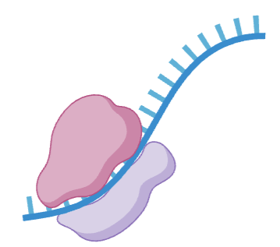



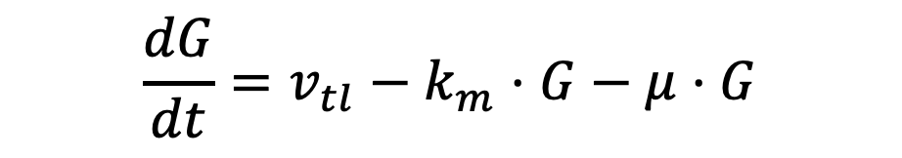
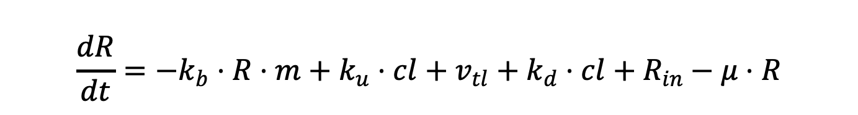
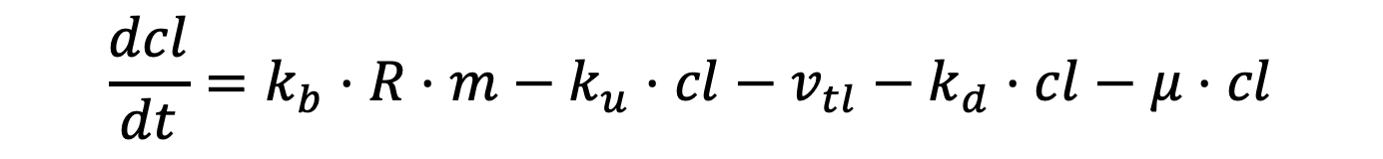

Modelling biological systems with ODEs
$$\frac{dcl}{dt}=k_{b}⋅R⋅m−k_{u}⋅cl−v_{tl}−k_{d}⋅cl−μ⋅cl$$
$$\frac{dG}{dt}=v_{tl}−k_{m}⋅G−μ⋅G$$
$$\frac{dG_{m}}{dt}=k_{m}⋅G−μ⋅G_{m}$$
$$\frac{dR}{dt}=−k_{b}⋅R⋅m+k_{u}⋅cl+v_{tl}+k_{d}⋅cl+R_{in}−μ⋅R$$

Slide 6
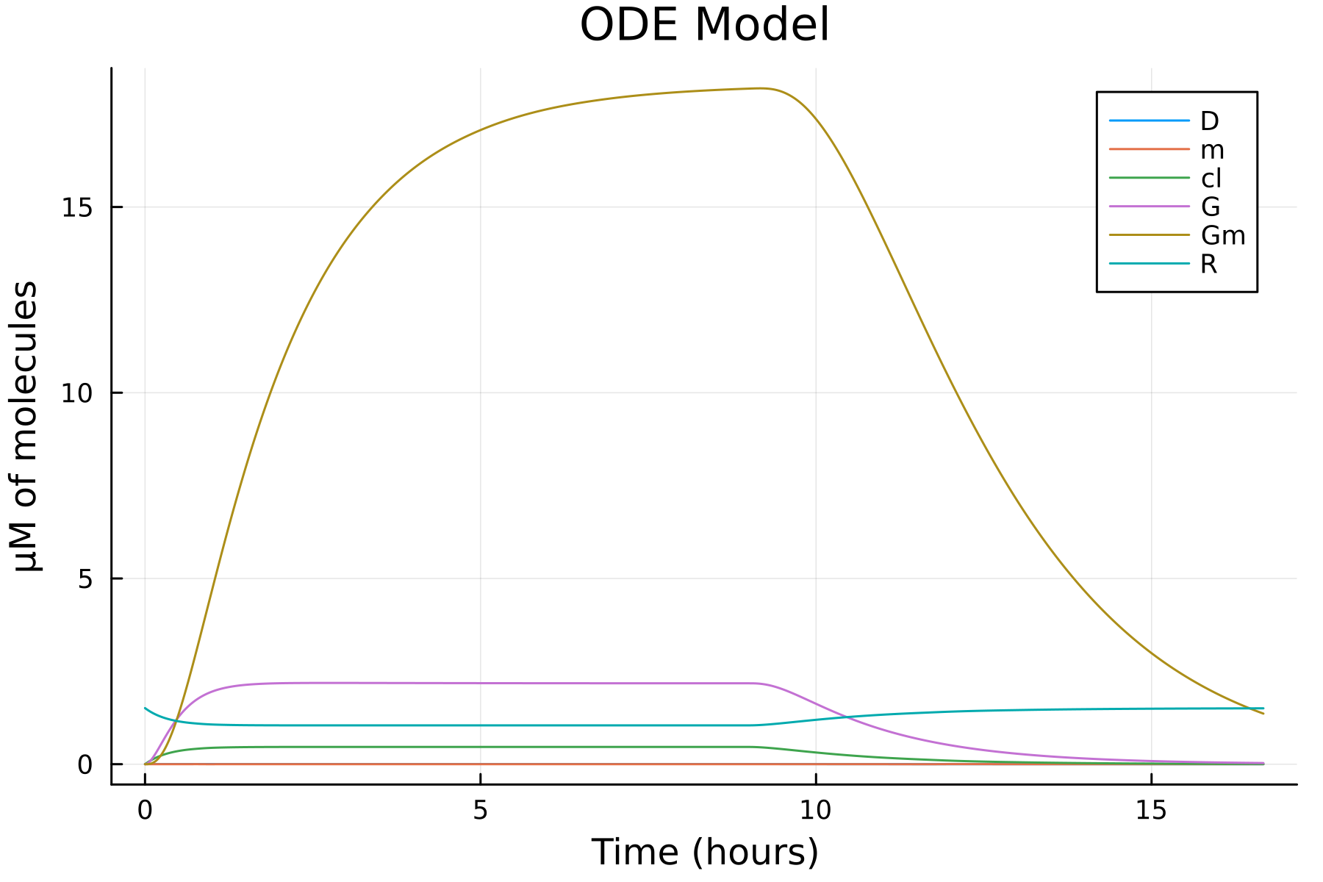

Slide 7
Optimization: where engineering meets biology

Slide 8
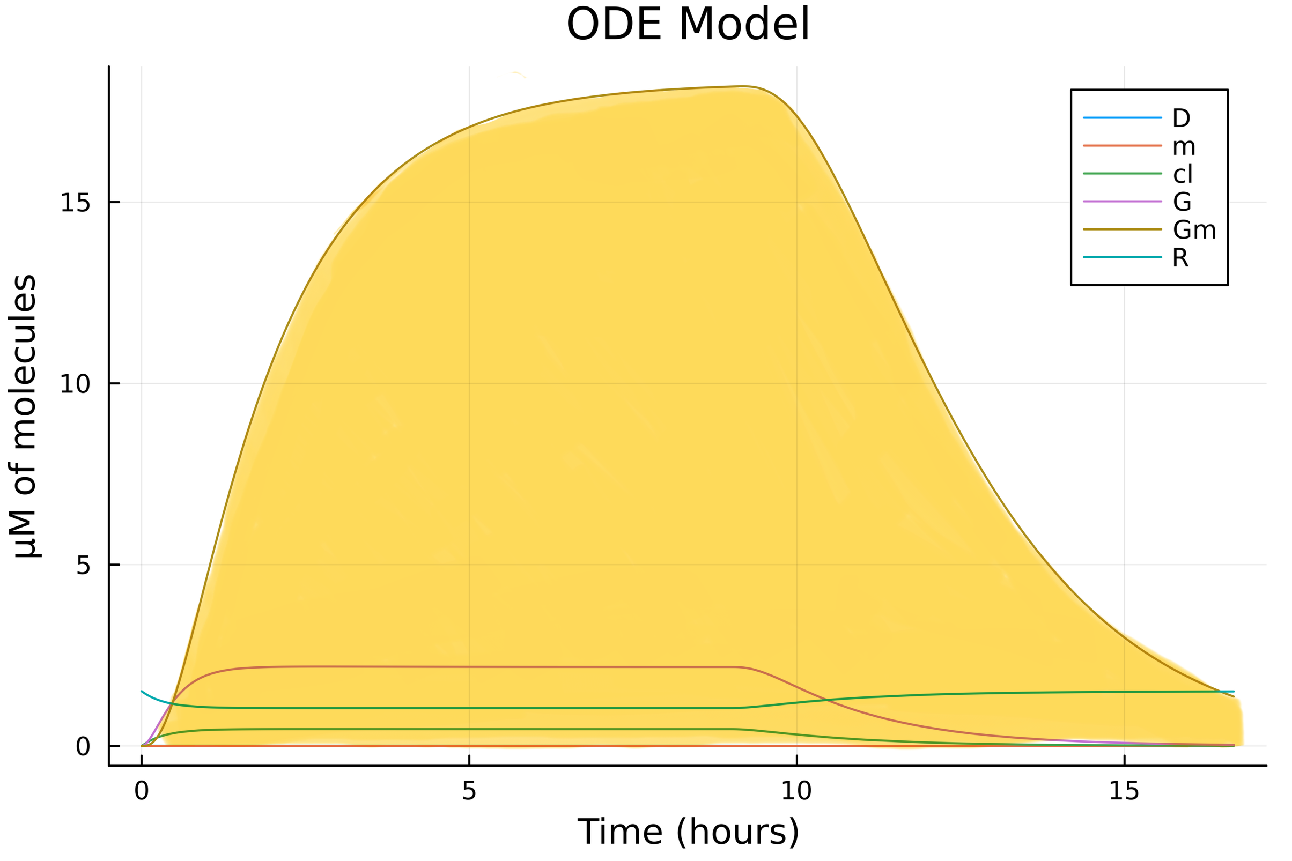
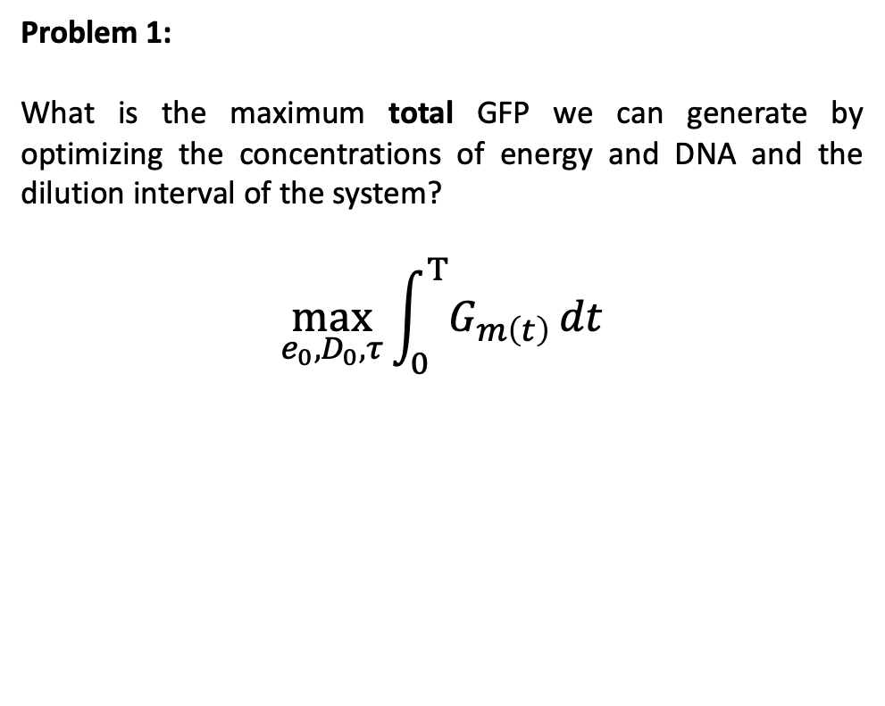
Optimizing a cell-free system
Problem 1:
What is the maximum total GFP we can generate by optimizing the concentrations of energy and DNA and the dilution interval of the system?
$$\max_{e_{0}, D_{0}, τ}{\int_{0}^{Τ}{G_{m\left(t\right)}}}dt$$

Slide 9
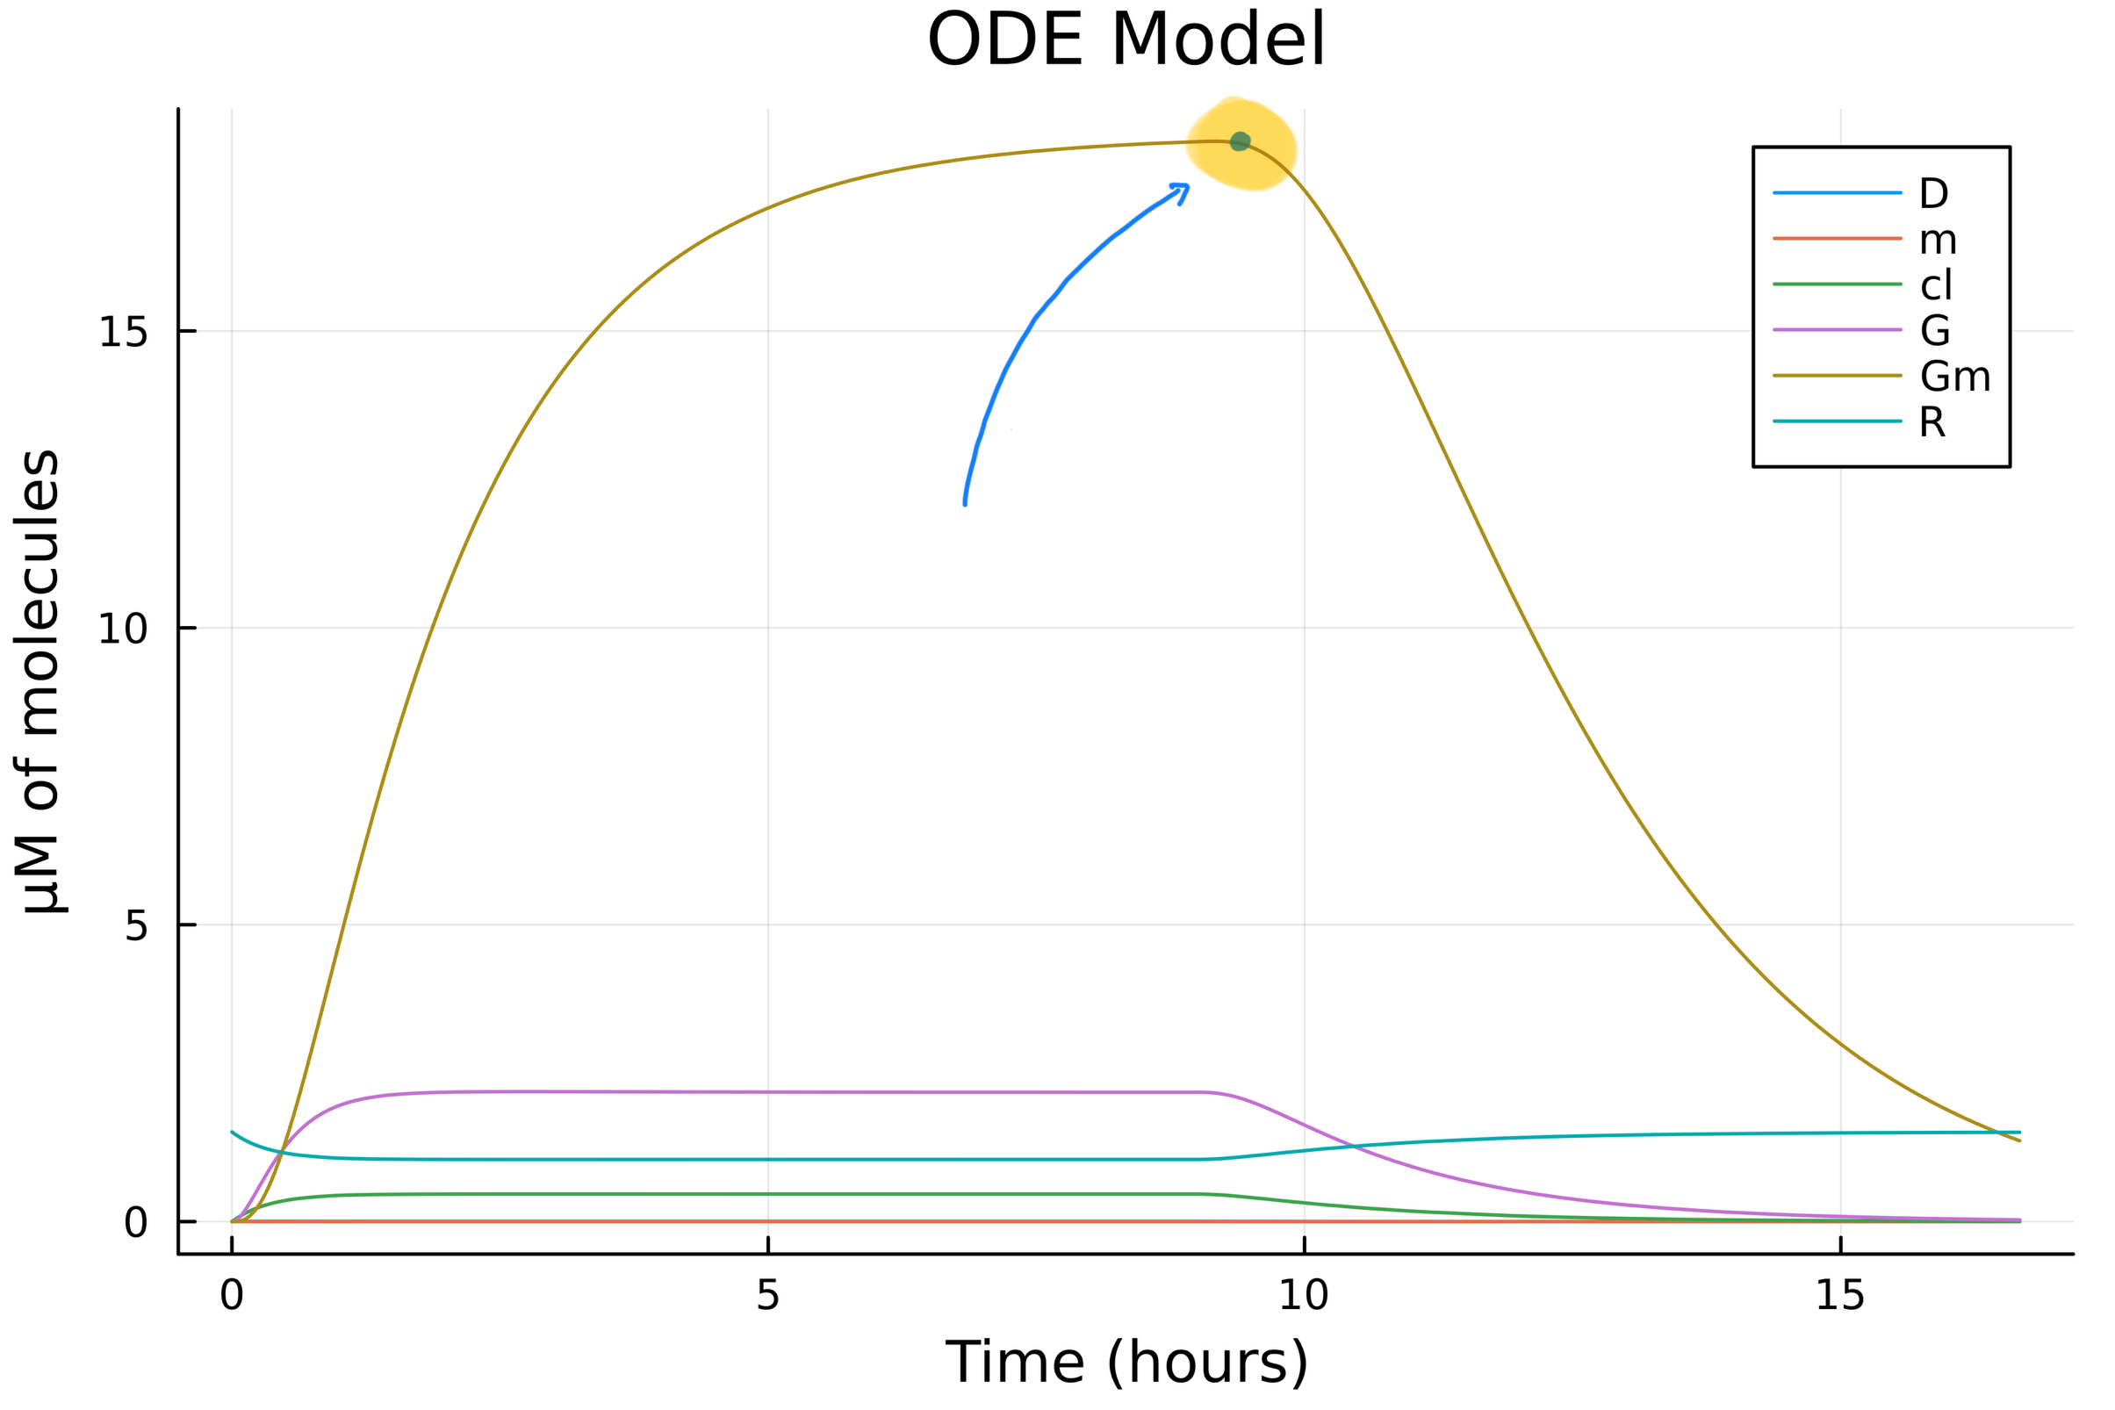
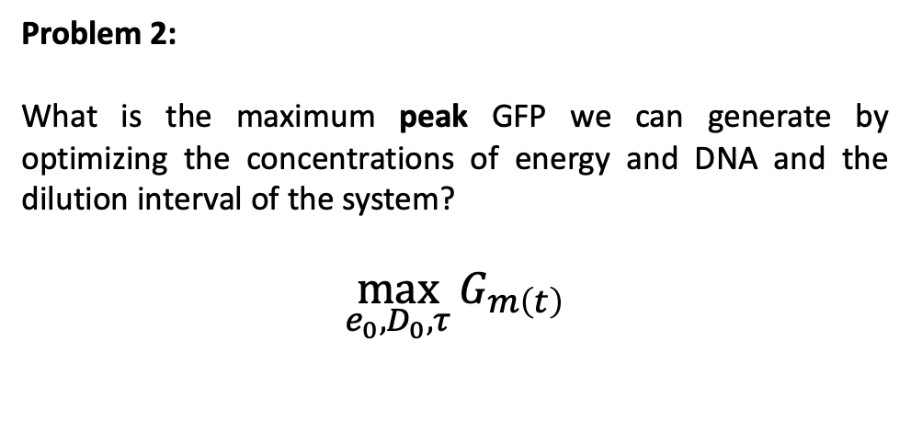
Optimizing a cell-free system
Problem 2:
What is the maximum peak GFP we can generate by optimizing the concentrations of energy and DNA and the dilution interval of the system?
$$\max_{e_{0}, D_{0}, τ}{G_{m\left(t\right)}}$$

Slide 10
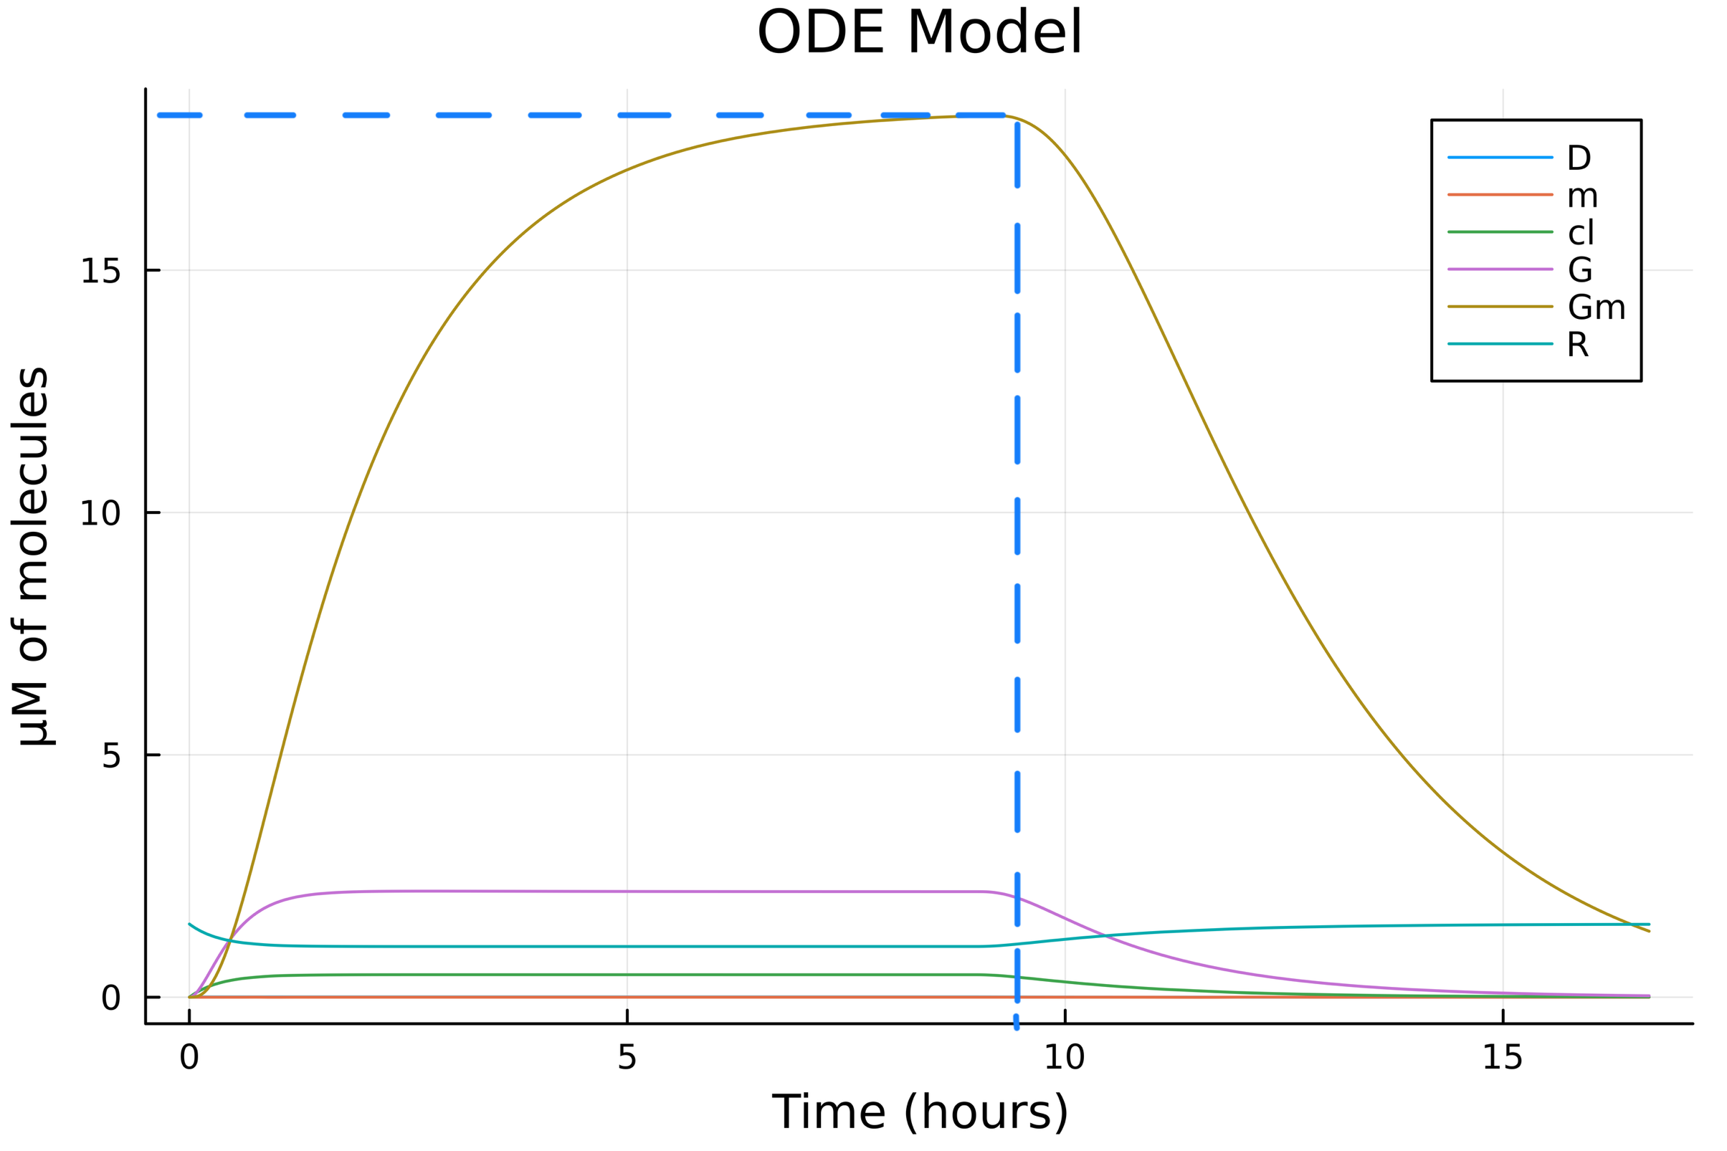
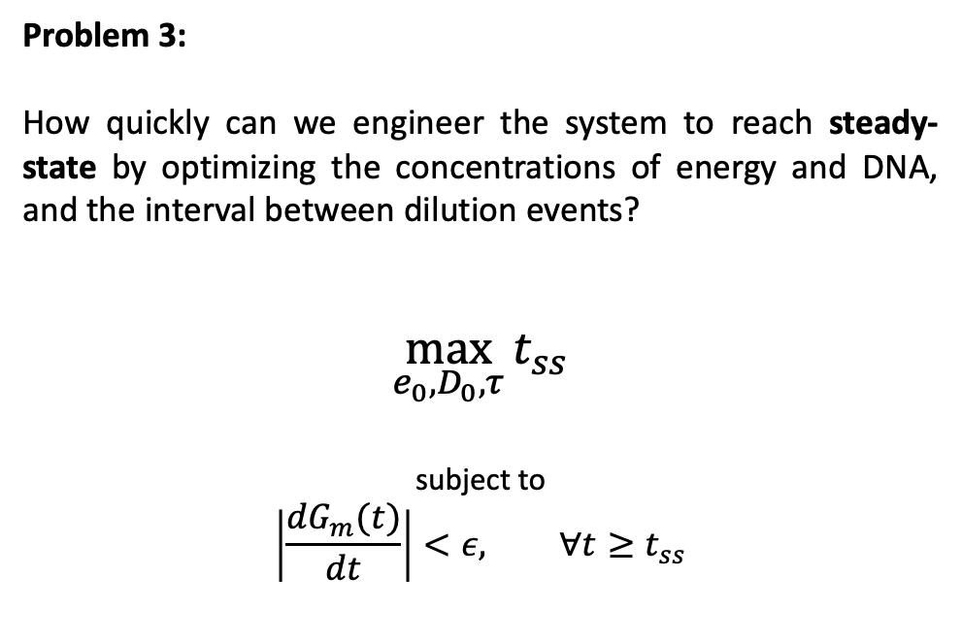
Optimizing a cell-free system
Problem 3:
How quickly can we engineer the system to reach steady-state by optimizing the concentrations of energy and DNA, and the interval between dilution events?
$$\max_{e_{0}, D_{0}, τ}{t_{ss}}$$
subject to
$$\left|\frac{dG_{m}(t)}{dt}\right|<ε, ∀t≥t_{ss}$$

